Slide 1
PROJECT REVIEW AND EVALUATION SYSTEM
Narsini Shravani 1602-20-737-039
Thodeti Shiva Charan 1602-20-737-038
Zoha Tabassum 1602-20-737-053

Slide 2
Problem Statement
Academic Project management whether Mini project or Major project is a major issue which is faced by many educational institutes, the main reason is there is no automated system followed in any institute.
College management/staff gather all the project reports and project sources from students and store them physically .As projects are important for every student ,our aim is to make them review and evaluate effectively.

Slide 3
Description about Project
.
●Project Review and evaluation system is a system which helps to review and evaluate the projects done by the students by their respective guides and hods in every academic year in every colleges.

Slide 4
Description about Project
Projects play an essential role in enhancing the learning experience for the students, as they involve in real life application of classroom knowledge. So, such an important academic quantity should be dealt with fairly and should be made sure that no mistakes happen when the idea of project is conveyed to the respective faculty. Offline submission surely has its merits of getting direct insights from the teachers, but having an online platform for submission is something that stays at a higher place.

Slide 5
REQUIREMENTS:
.
● VSCODE
●SQL
● HTML
●CSS
●FLASK
●NLP

Slide 6
MODULES DESCRIPTION:
STUDENT REGISTRATION AND LOGIN
The team of student will login with their team-name as username and a password. If the account doesn’t exist, they will be redirected to the registration page.
Once they login, they will be able to submit their abstracts to guide and will be able to view the status of their project abstracts.

Slide 7
GUIDE LOGIN AND REGISTRATION
Similar to student’s web pages, the guide can login with their username and password.
They will be able to approve or reject the abstracts they receive and may give feedback accordingly.

Slide 8
HOD LOGIN
HOD will be able to approve or reject the abstracts they receive and may give feedback accordingly.
A team can submit abstracts only if their guide has accepted.
HOD can view all final project details.

Slide 9
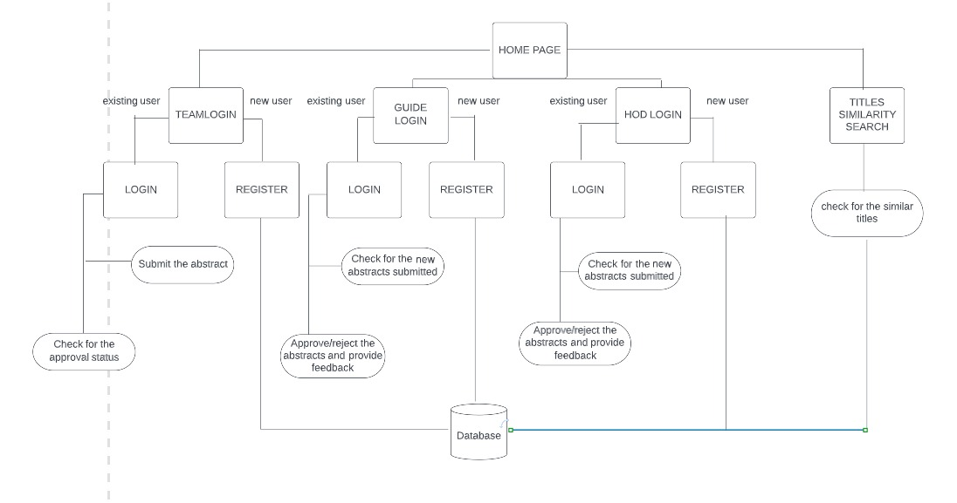
ARCHITECTURE:

Slide 10
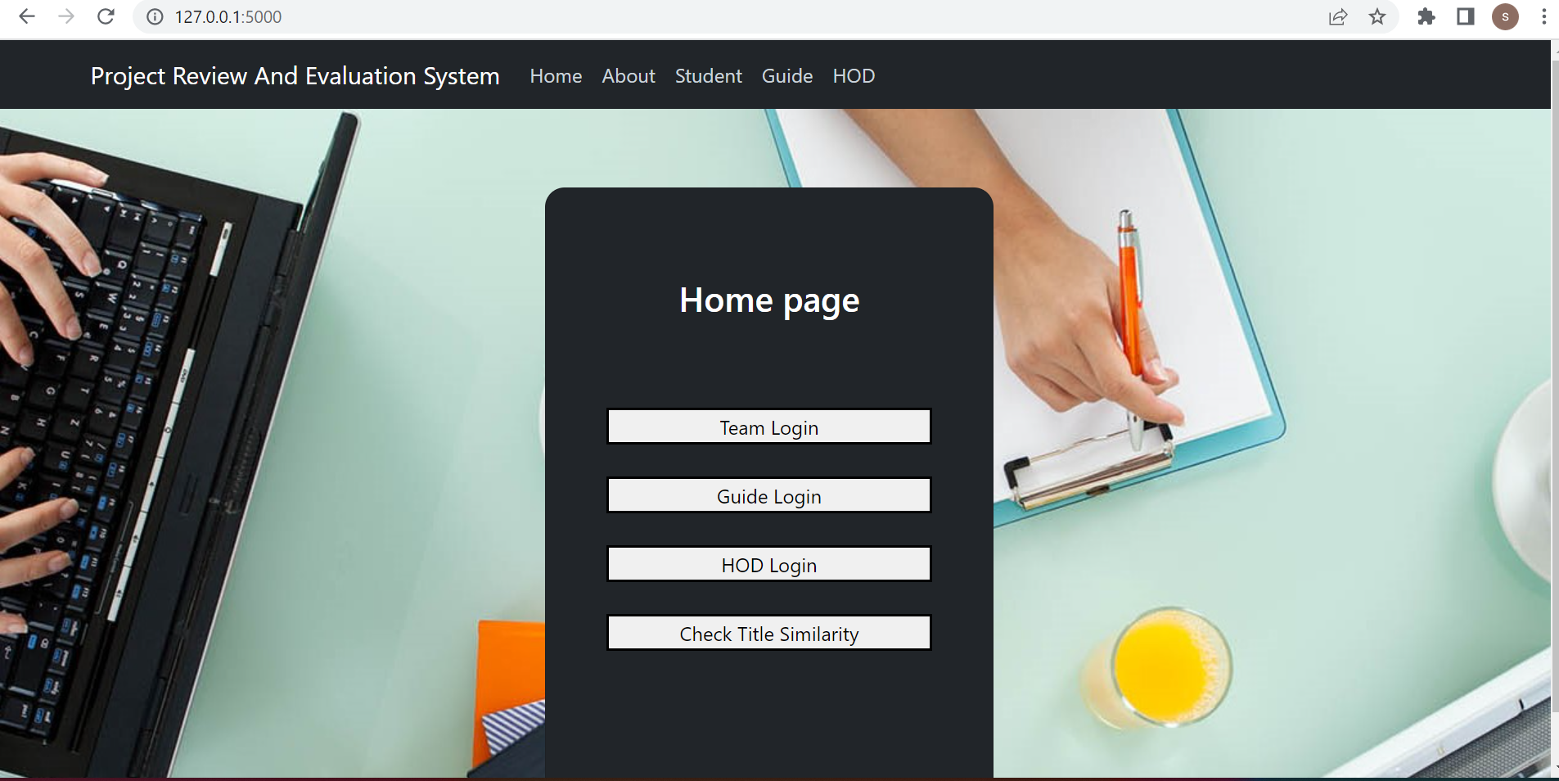
RESULTS

Slide 11
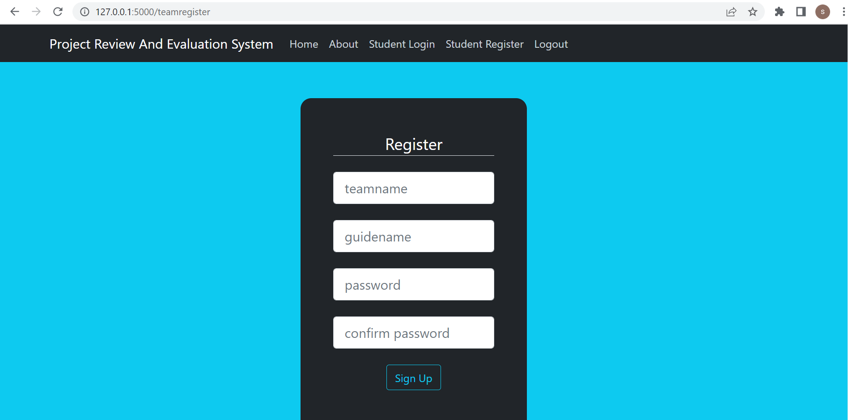
TEAM REGISTRATION PAGE:

Slide 12
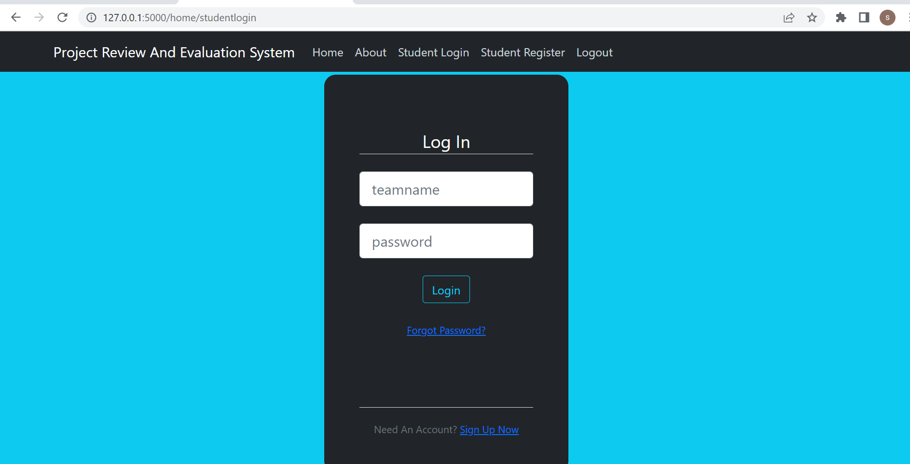

Slide 13
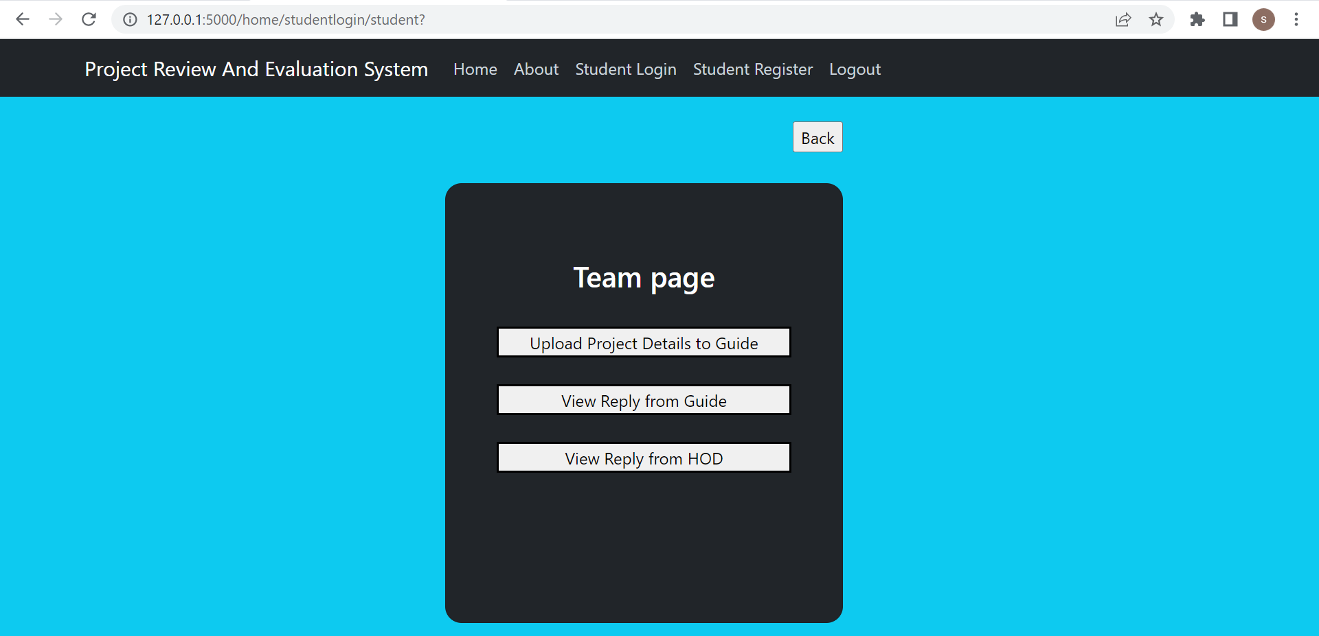

Slide 14
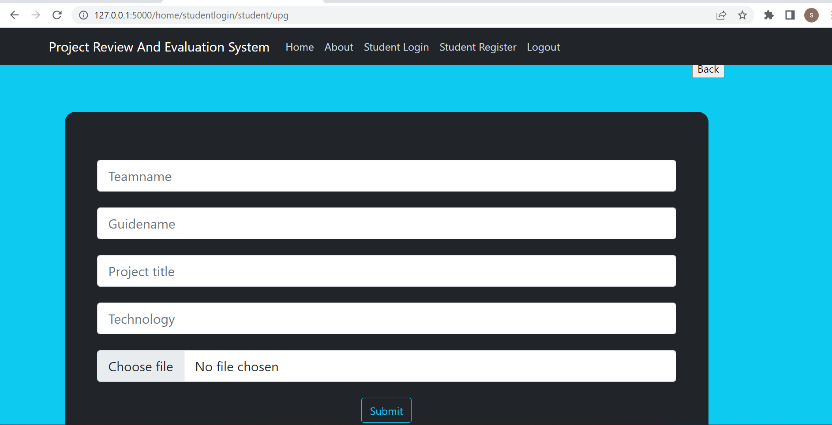

Slide 15
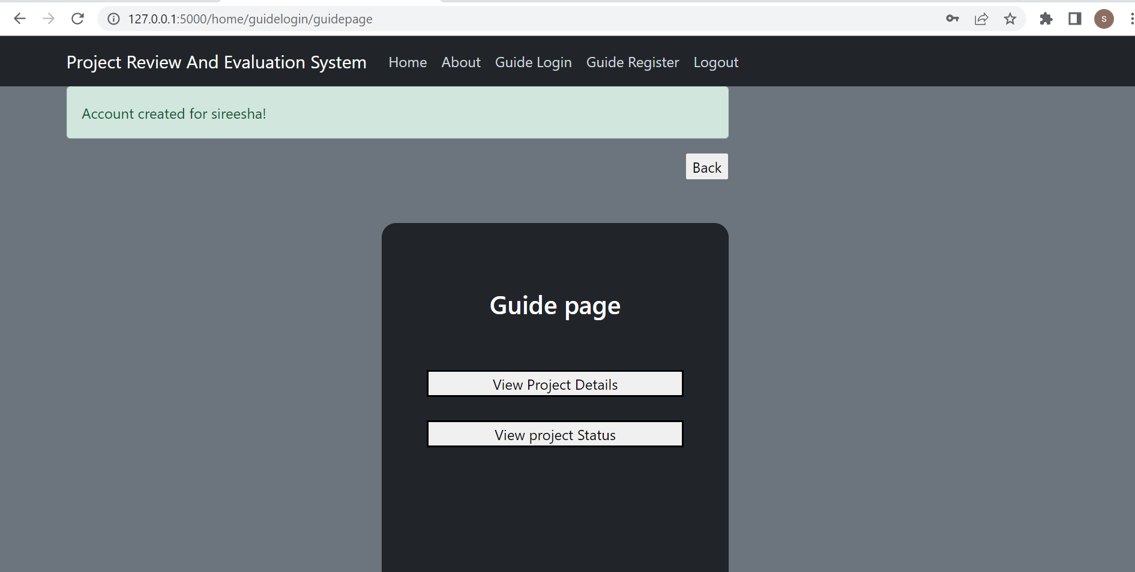

Slide 16
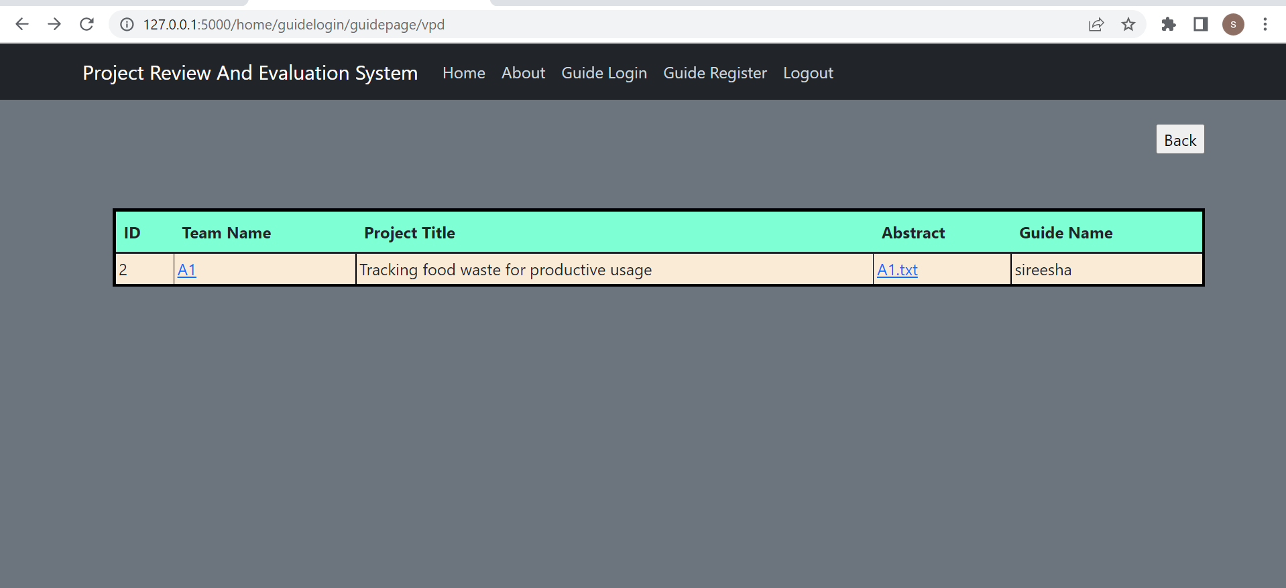

Slide 17
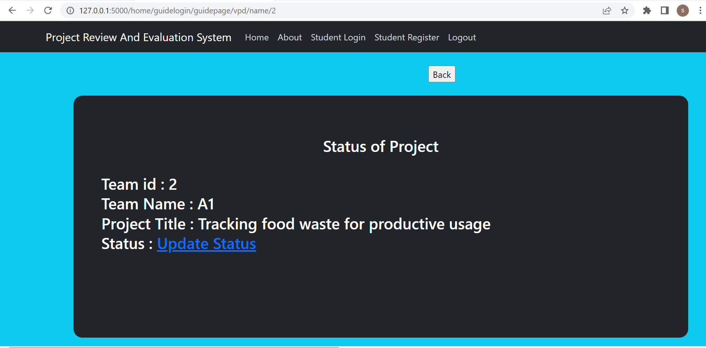

Slide 18
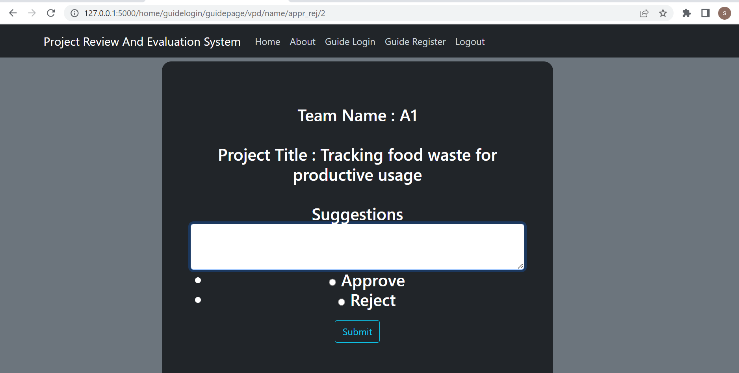

Slide 19
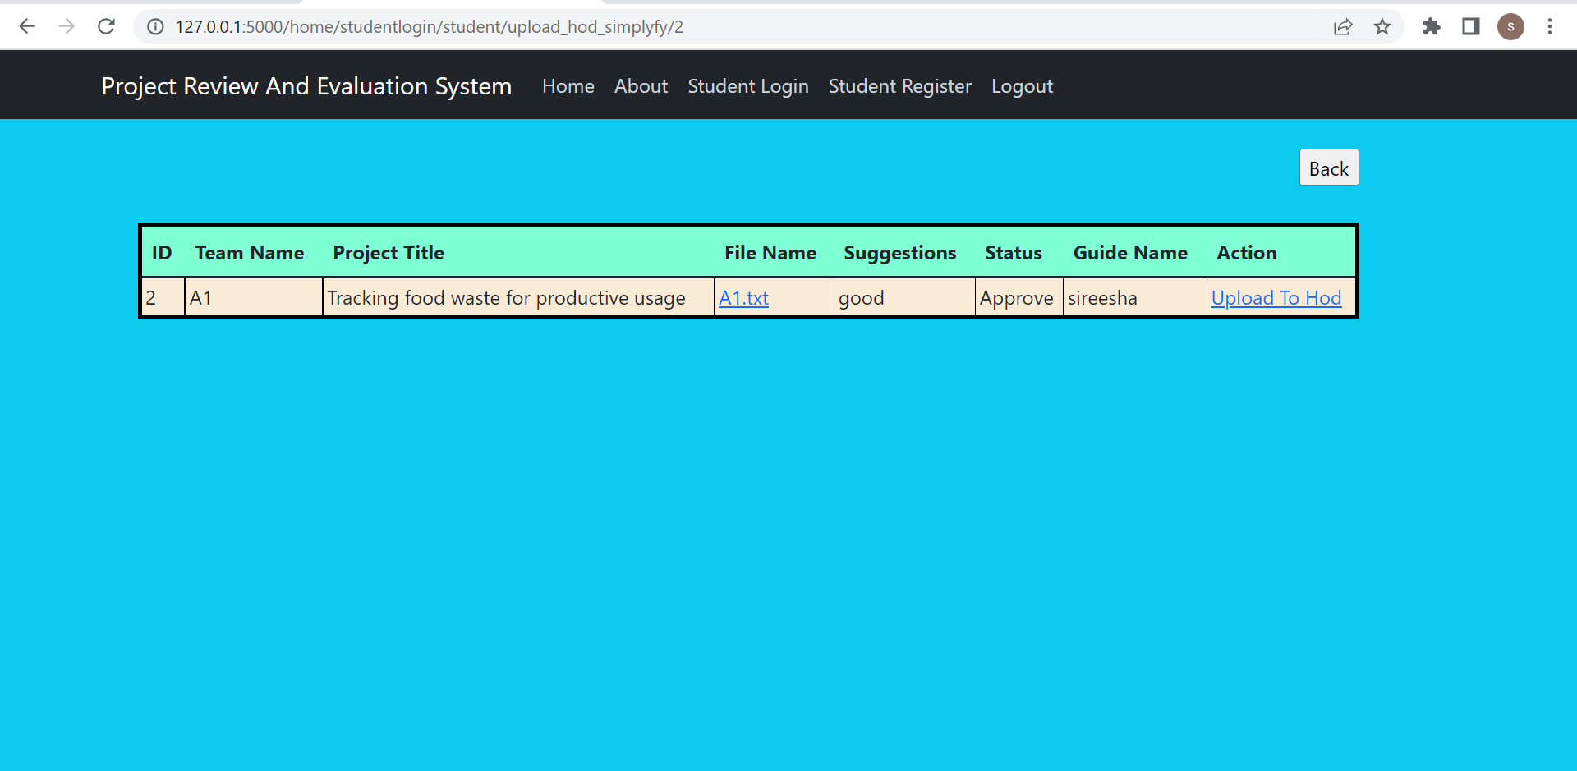

Slide 20
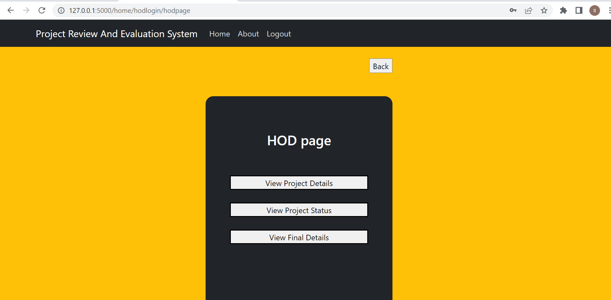

Slide 21
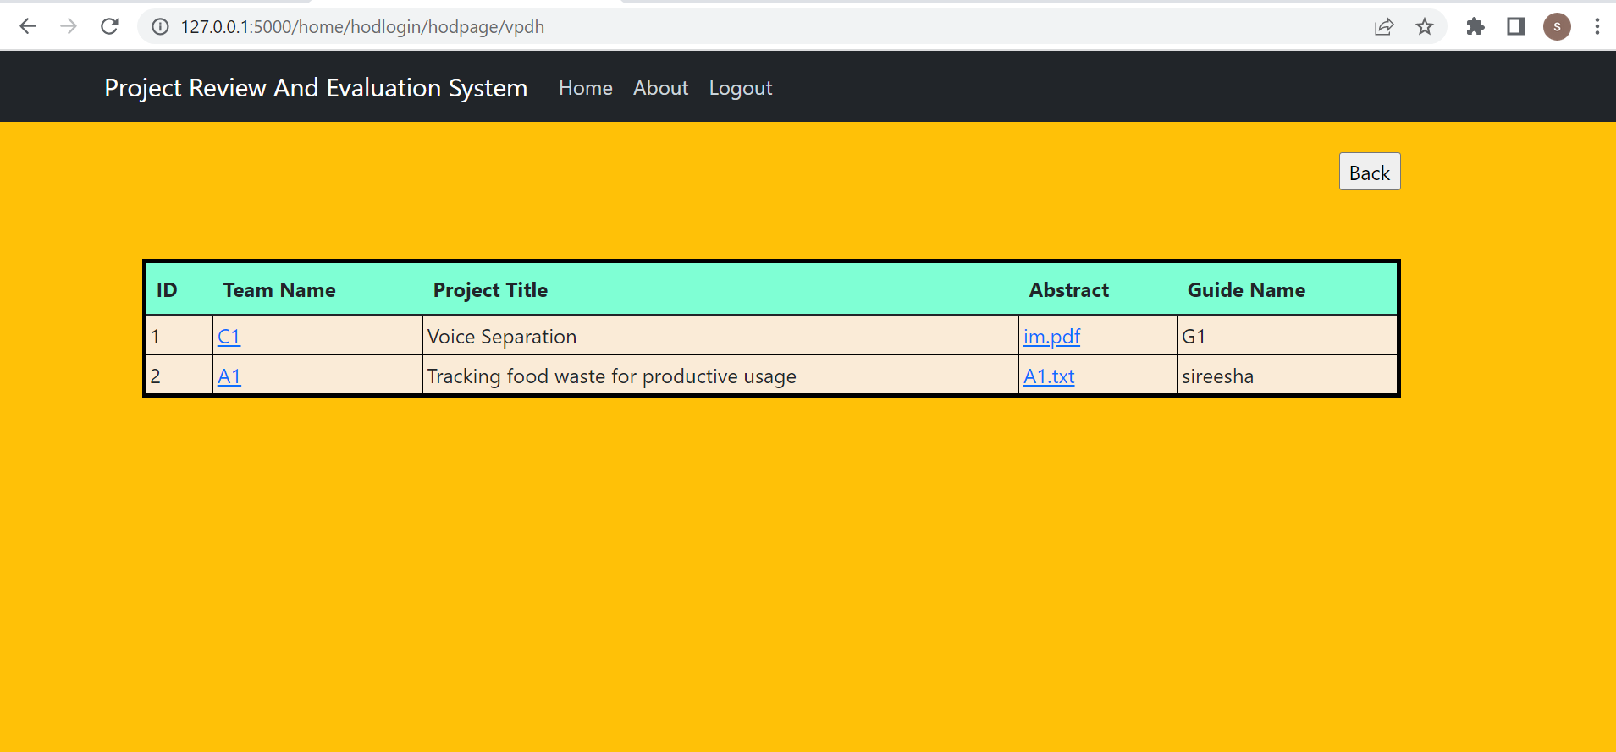

Slide 22
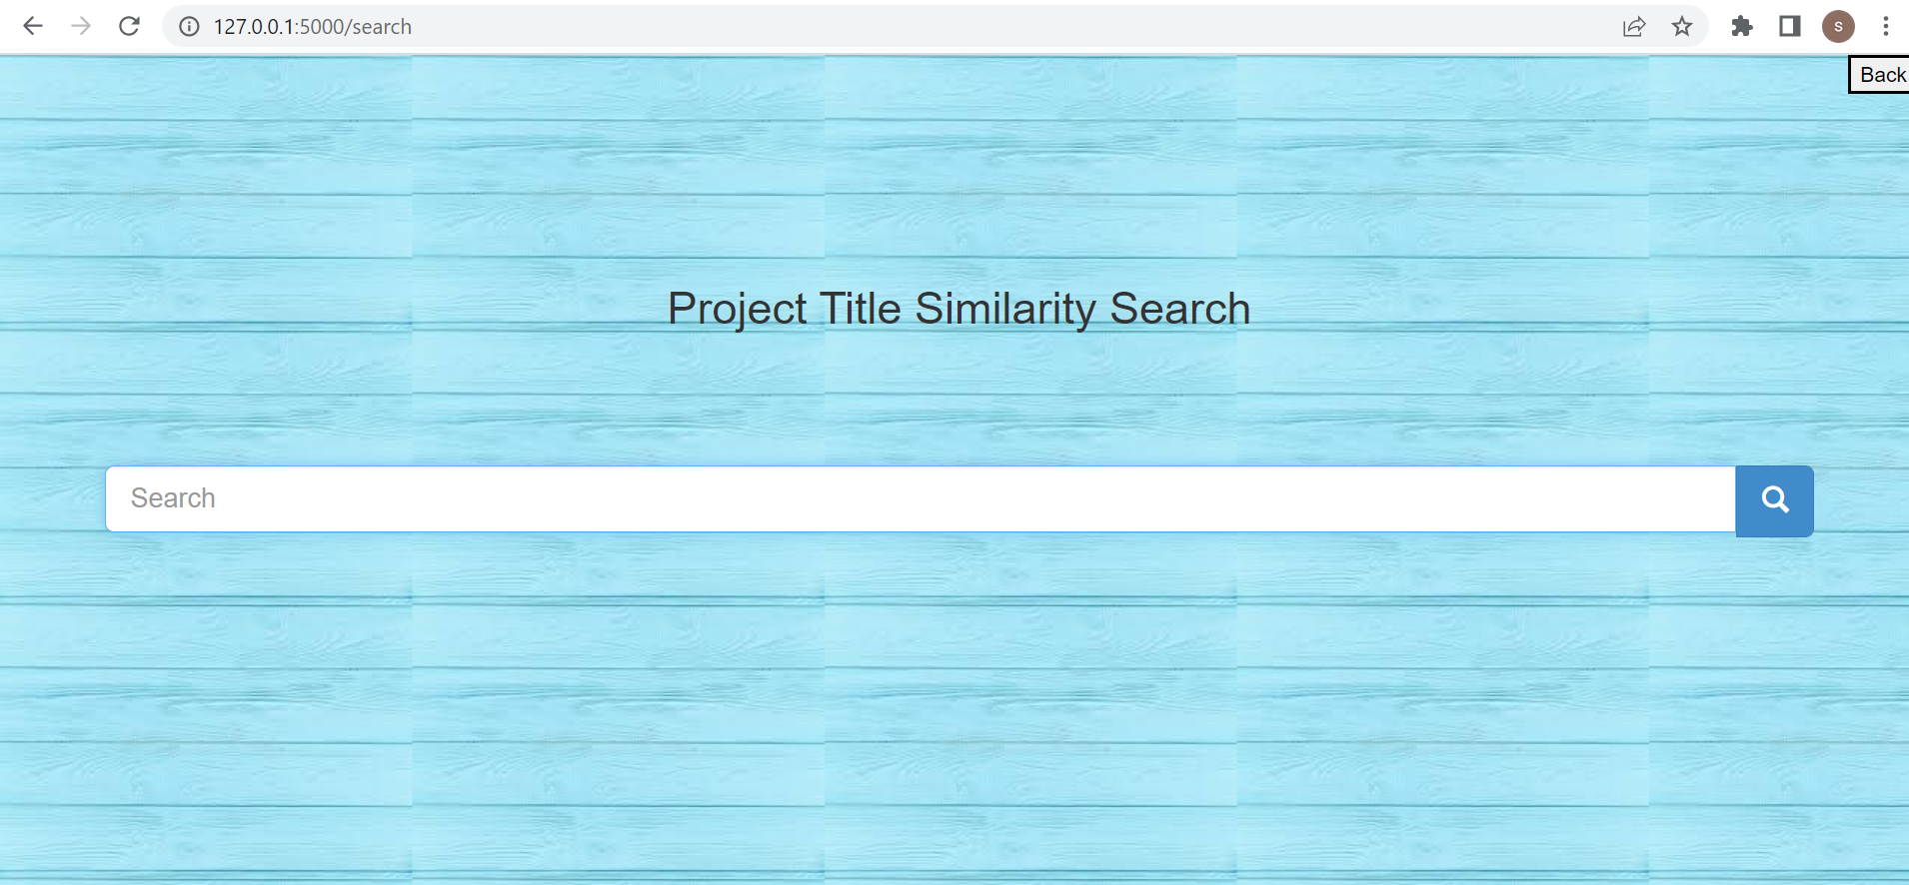

Slide 23
CONCLUSION AND FUTURE SCOPE:
The project review and evaluation system is aimed at automating the existing manual system for review and evaluation of project and process the approval request through faculty
Alerts or notification module can be added separately which will show notification icon and which when clicked will open the related information for which notification was received.

Slide 24
References
https://www.academia.edu/28590094/An_Integrated_Project_Evaluation_System

Slide 25
THANK YOU

